Slide 1

Sauce & Spoon
Tablet Rollout
Impact Report

Slide 2
Executive Summary
Sauce and Spoon set out to streamline our dining experience at two locations by implementing a tablet-based ordering system to encourage customer interaction with our media sources, cut down on order inaccuracies, and decrease the table turn time to encourage faster dining experiences thus leading to more revenue(more customers able to be seated). The initial rollout was set for the bar, and on October 15th the rollout was completed. Customer feedback has been positive towards the change leading to an increase in foot traffic at both locations(20%).
After rollout our revenue increased by 20% in July from April, as well as our food waste has been cut down by 50%. Our daily guest count has increased by 10%, and our tablets have decreased wait times by 30 minutes. Customer satisfaction has increased from 72% to 86% according to surveys.We have implemented table audits to ensure the devices are functioning as intended and we have taken steps to shorten the checkout time to a minute with the tablet system.

Slide 3
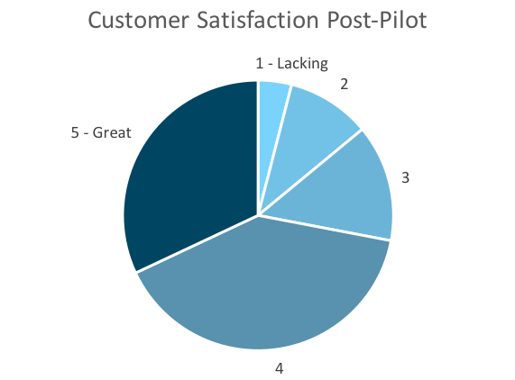
Customer Satisfaction: Pilot
Q. On a scale of 1-5, please rate your experience with the tablet overall.
This pie chart illustrates the results from the post-pilot survey.
72% of respondents indicated a customer satisfaction score of 4 or 5.
Notes:
First pie chart: Results from the post-pilot survey
Second pie chart: Results from the post-launch survey, after making changes
Satisfaction has gone up from 72% (4 and 5 rating) to 86% (4 and 5 rating)
Post-pilot data:
1 - Lacking 2 4%
2 5 10%
3 7 14%
4 20 40%
5 - Great 16 32%
Post-launch data:
1 - Lacking 1 2%
2 2 4%
3 4 8%
4 22 44%
5 - Great 21 42%

Slide 4
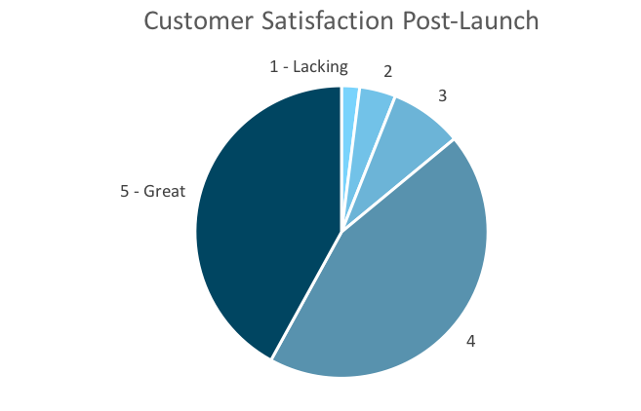
Customer Satisfaction: Launch
Q. On a scale of 1-5, please rate your experience with the tablet overall.
This pie chart illustrates the results from the post-launch survey.
86% of respondents indicated a customer satisfaction score of 4 or 5. This is a 14% increase.
Notes:
First pie chart: Results from the post-pilot survey
Second pie chart: Results from the post-launch survey, after making changes
Satisfaction has gone up from 72% (4 and 5 rating) to 86% (4 and 5 rating)
Post-pilot data:
1 - Lacking 2 4%
2 5 10%
3 7 14%
4 20 40%
5 - Great 16 32%
Post-launch data:
1 - Lacking 1 2%
2 2 4%
3 4 8%
4 22 44%
5 - Great 21 42%

Slide 5
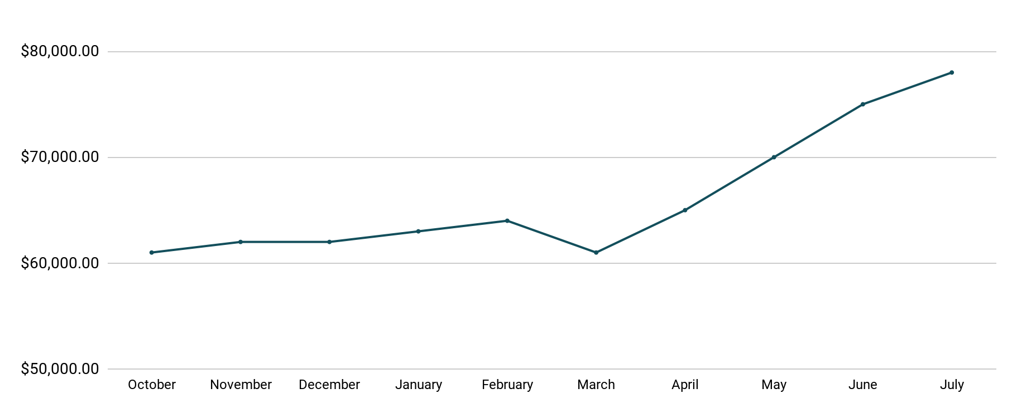
Revenue
Tablet Launch April 23
This is a chart of Sauce & Spoon revenue, showing that after tablet implementation, revenue increased.
July revenue was up to 20% over April’s monthly revenue.
Notes:
This is a chart of Sauce & Spoon revenue, showing that after tablet implementation, revenue increased. December revenue was up to 20% over September’s monthly revenue.
Sales data:
October
$61,000.00
November
$62,000.00
December
$62,000.00
January
$63,000.00
February
$64,000.00
March
$61,000.00
April
$65,000.00
May
$70,000.00
June
$75,000.00
July
$78,000.00

Slide 6
What Worked: Key Accomplishments
Decreased table turn time
Implementation of the tablets increased the average daily guest count by 10%.
Tablets also decreased wait time by 30 minutes.
Decreased food waste
Tablets identified who was receiving an incorrect order.
Kitchen staff has taken the initiative to correct orders and decrease food waste by 50%.
Increased customer satisfaction
After the pilot, customer satisfaction was at 72%.
Once we implemented improvements based on feedback, customer satisfaction increased to 86%.
Increased sales
Our monthly revenue has increased steadily since the tablet rollout, upwards of 20% since September/pre-rollout.
Tablets also helped boost revenue during the holiday season.

Slide 7
Next Steps: Looking Forward
Initiative | Action | Date
Implement tablets in more locations | Create new project plan for new location installation | Q2
Continue to track customer experience and satisfaction | Continue surveying/ gathering data through various means | Ongoing
Expand tablet features | Investigate new features like social media integration, reservations, videos, etc. | Q4

Slide 8
Appendix
Access all resources here.
Notes:
Insert link to your shared drive or a shared folder with all of the relevant project artifacts

